Slide 1
Pacman
BY Bo & Bryan

Slide 2
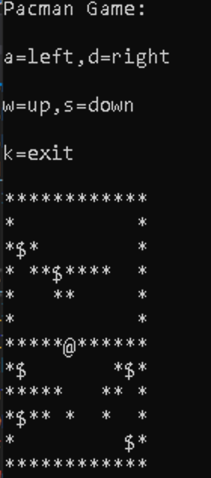
Pacman Layout and controls
‘@’ pacman
‘*’ wall
$’ ghost
‘#’ de-ghost
‘-’ demo path
User is able to use the a,w,s,d keys to move through the map.
The user is also able to exit the program by pressing k

Slide 3

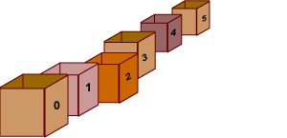
File to Array and Positions
First create a map file and use library code to read from a file
Than we used a function to copy the file to an array.
Once we have the array we looked through the whole array to find the positions of the pacman,ghost and count how many ghost there are in the map.

Slide 4


User Input and Check Move
Function to read user char input and store to variable called User_Input
After the user_input function call the next function is to check if the user move was correct. This function checks for wall and Ghost.
If the user move was a wall than a wall flag boolean will turn on and if the move is ghost than ghost flag is on.

Slide 5
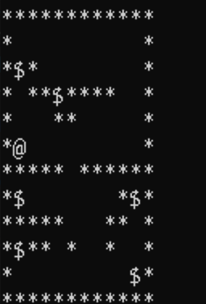
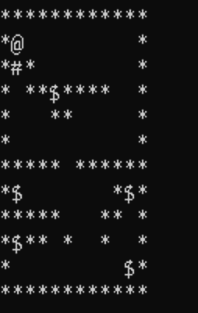


Update game display
The Update game function changes the array to show the dead ghost and update the pacman move.
If the wall flag is on than there is no update to the array. If the ghost flag is on than when the pacman moves from the dead ghost position it will write ‘#’ to the array.

Slide 6
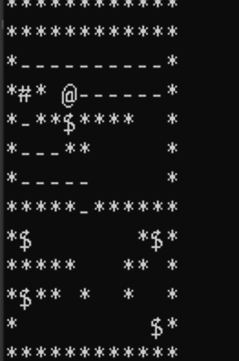
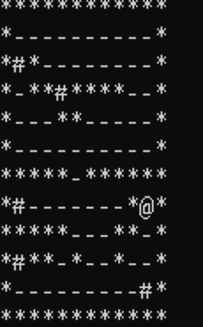
Demo
Demo still uses check move and update game function. Except it marks ‘-’ for path taken and in check move sees ‘-’ as a wall.
The demo function is a recursion that makes user input L,R,U and D. Checks the move and return if blocked in. If blocked in than return from previous position and mark the position you’re on. This runs unit ghost is found.

Slide 7
Experience
By doing pair coding, we realize we were doing from brain storming about algorithm to debugging at the same time. It will fun and productive.
By separating the functions, we have to make a greetment about whole plan of the application, and go many times in order to deal into a really deep level, such as each function’s input, output. During this process we realize a totally different way from each other, such as…

Slide 8


